Slide 1
Sur5val
How the jam works
Note: for 15 teams, at 2 ½ minutes a bout, that’s 105 Jams over 4 1/2hours!!!
Notes:
To make this a round robin tournament or Sur5val bout, where each team plays each other, then for this example, there would be n/2(n-1) jams where n=6, so we would have 6/2(6-1) jams which is 15 jams, if each jam runs for 2 ½ minutes then you have the bout taking 37 ½ minutes.
For 15 teams, it works out at 15/2(15-1) times 2 ½ minutes and that is 105 jams over 4hrs 22 mins!!! ⬅
Lastly, this process requires
a) a clear, closely located area where the teams can sit - Benches
b) a NSO to ensure the correct teams are notified to move from the Benches to the Trackside seats – they have 2 minutes to do this.
This presentation is based on what Windsor Roller Derby (UK) did for their Sur5val

Slide 2
Heats and Jams
We will have 3 rounds of 5 heats, each heat has 7 Jams
Each heat runs for 20 – 25 mins
Between each heat, there will be a 2 min break
Between each round there will be a 10 min break

Slide 3
Scoreboards
There will be two projectors displaying
The current jam
The current heat roster or the team score
Notes:
They could all display on 1 screen, it would be cluttered though
The best solution would be to have three separate screens, operating off three laptops projecting on the rear wall.
The current jam would be real time – like the CRG scoreboard show the score as it happens
At the end of the heat, the results would be transferred to the other PC’s via (wireless)

Slide 4
How will the Heats run?
Lets look at an example using 4 teams having 3 jams (as they fit nicely in Powerpoint!)
On the day we would have in a heat, 7 teams and 6 jams
Notes:
The Sur5val package and other applications can quickly generate team schedules – just Google round robin tournaments, enter the number of teams and tracks available and …

Slide 5
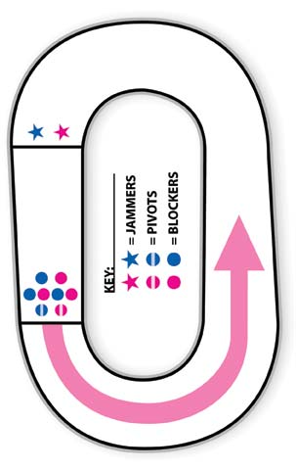
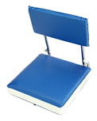
The Start -the start of Heat 1 and Jam 1
Benches
Team A
Team B
Team C
Team D
#1 Teams A and B sit in the benches waiting for the start of the bout
Notes:
In this example we have 6 teams , we will have 7 in practice

Slide 6
Start of the Jam
Benches
Team A
Team B
Team C
Team D
#2 Start of the bout, Teams A and B have 30 seconds to enter the track

Slide 7
During the Jam
Benches
Team A
Team A
Team B
Team B
Team C
Team D
#3 During the Jam

Slide 8
End of the Heat
Benches
Team B
Team A
Team A
Team B
Team C
Team D
#4 After the Jam, Teams A and B return to their Benches, Teams C and D enter the track

Slide 9
During the Jam
Benches
Team A
Team C
Team D
Team B
Team C
Team D
#5 During the Jam… then repeat swapping the teams, running the jams until this heat is completed

Slide 10
End of the Heat
#7 All teams exit to the skater rest area
Benches
Team A
Team B
Team C
Team D
Skater Rest Area
Notes:
There are 5 mins between each heat for skaters to transition to and from the skater rest are and Benches, for the NSO’s and Ref’s to swap teams.

Slide 11
End of the Heat
We have 2 minutes to:
Replace the teams on the benches
Replace the referees and NSO’s as required
Update scoreboards, the team running score and next team roster
Update the Board of “Shame”
Deal with any issues
Notes:
Windsor did ‘The current plan is for refs and NSO’s to rotate after every 2 heats (so approximately 45/50 minutes).’

Slide 12
Setup for the next Heat
#8 The next teams move to their Benches from the skater rest area
Benches
Team E
Team E
Team F
Team F
Team A
Team G
Skater Rest Area
Notes:
There are 2 mins between each heat for skaters to transition to and from the skater rest are and Benches, for the NSO’s and Ref’s to swap teams.

Slide 13
End of the Heat
Then repeat, running jams and heats
until
we have finished the round
Notes:
Windsor did ‘The current plan is for refs and NSO’s to rotate after every 2 heats (so approximately 45/50 minutes).’

Slide 14
End of the Round
We have 20 minutes to:
Replace the teams on the benches
Replace the referees and NSO’s as required
Update scoreboards, the team running score and next team roster
Update the Board of “Shame”
Deal with any issues
Notes:
Windsor did ‘The current plan is for refs and NSO’s to rotate after every 2 heats (so approximately 45/50 minutes).’

